Slide 1




The Kinetics of Phase Formation and Microstructure Development of High Purity Silicon Nitride Ceramics
Si₃N₄
Shyanne Dustrud
Northern Arizona University
Mark Hawthorne, ATC Materials
Notes:
Introduce yourself and read off the title, state who you are with: NAU and ATC Materials out of Flagstaff, AZ.

Slide 2
Si₃N₄ Ceramics
Desirable electrical properties for RF applications
  Antenna parts
  Radomes
  RF windows
Fully capable of surviving re-entry temperatures
  Continuous use at 1400°C
  Up to 1700°C for shorter periods
High temperature strength
Superior thermal shock resistance
Low density
Good fracture toughness
Excellent wear resistance
Applications to Aerospace Engineering
Notes:
Discuss application to aerospace engineering. WHY is this important? STATE that beta phase increases all of these factors as well as higher purity.

Slide 3
Silicon Nitride Microstructure
Acicular
Beta phase
Equiaxed
Alpha phase
Notes:
Si₃N₄ Has multiple phases, but beta phase has preferential growth direction and manifests as a fiber-like phase which insitu reinforces the ceramic.

Slide 4
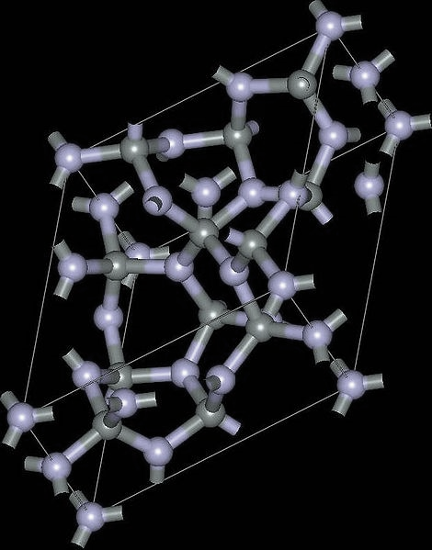
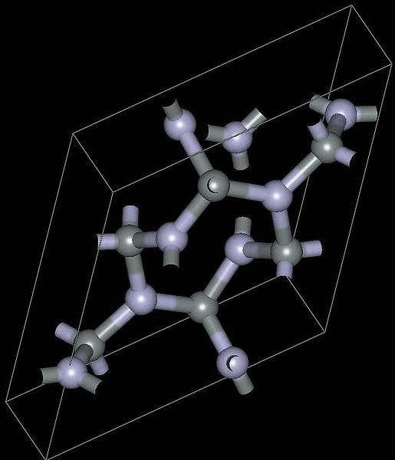
Si₃N₄ Phases
α
β
Pressureless Sintering
Alpha phase transitions into beta phase under high temperature pressureless sintering.

Slide 5
Goals of the project
Focus on beta phase in higher purity silicon nitride with minimal additives via crystal structure and microstructure
Analysis of pre-existing data to determine factors that influence phase transitions
Design and perform experiments to maximize desired microstructure and phases in order to optimize mechanical and dielectric properties
Notes:
Silicon nitride is a moderately well studied ceramic material, but there is a significant lack of focus in the higher purity material. (Lowering additives as much as possible.) For my project I first began with analysis of pre-existing x-ray diffraction data to identify key factors in the phase transitions in question.
Self reinforces itself. Add something about beta phase. It’s an in-situ fiber reinforcement within the material.

Slide 6
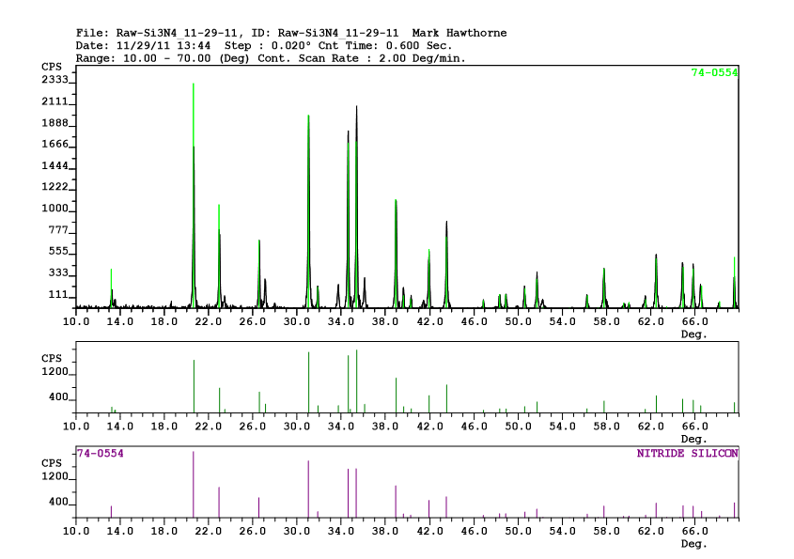
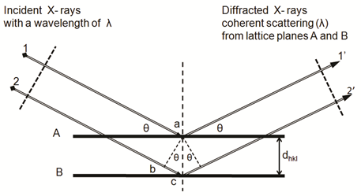

Powder X-Ray Diffraction
Primary method of semi-quantitatively determining the composition of phases within Si₃N₄.

Slide 7
Scanning Electron Microscopy
Qualitative analysis of the microstructure of phases present

Slide 8
Sintering Experiment
Recipe | Al₂O₃/Y₂O₃ | MgO | β% @1450º C | β% @1600º C | β% @1750º C
1 | 3.5% | - |  | 22.2 | 100
2 | 7% | - |  | 24.6 | 100
3 | - | 0.5% |  | 19.9 | 100
4 | - | 1.5% |  | 15.7 | 100
5 | 1.5% | -
6 | - | 3.5%
High Purity |  |  |  | 10.3 | 79.9
Notes:
Starting composition of powder
10% beta? Look up

Slide 9
Conclusions
Increasing sintering temperatures to 1750ºC transitions all alpha to beta phase.
  Desired microstructure did not purely manifest
Higher amounts of additives increase amounts of oxide impurities in final product
Now that beta phase can be concentrated, further research will be done into how the microstructure develops.

Slide 10
Acknowledgements
Mark Hawthorne and Sam Dauderman at ATC Materials
Dr. Nadine Barlow and Kathleen Stigmon with Space Grant
NASA
Aubrey Funke, M.S. with the NAU Imaging and Histology Facility
Thank you

Slide 11
Si₃N₄ Ceramics
Si₃N₄ Has multiple phases, but beta phase has preferential growth direction and manifests as a fiber-like phase which insitu reinforces the ceramic.

